Slide 1
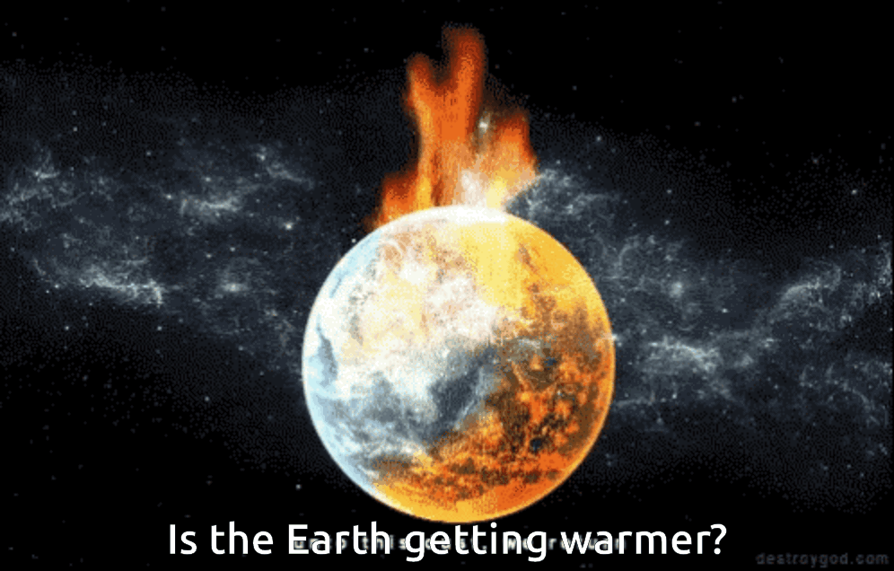




SIRIUS
POWERPOINT TEMPLATE
facebook.com
twitter.com
mail@mail.com
+81 12 3456 7890

Slide 2
THERMAL WARMING?
Who updates this : Albert
A STUDY OF GLOBAL TEMPERATURE, CO2 AND RADIATION
Describe the core message or hypothesis for your project.
Describe the questions you and your group found interesting, and what motivated you to answer them
Summarize where and how you found the data you used to answer these questions

Slide 3
ASSUMPTIOPNS
UOM
RADIATION
GHG
All values are at global levels measured in metrics(???). Currently we are getting data as
SOLAR RADIATION
Greenhouse Gases (GHG)
Temp in Centigrade
Solar Radiation in Watts/m2
CO2 and Air quality in metric tonnes / m2
Solar Radiation Comes as Total Solar Irradiance for NRL2 NASA project which takes care of uncertainties / measurement variations
Out of Greenhouse Gases (GHG), maximum contribution towards temp rise comes from CO2. So other GHG are ignored

Slide 4
HELLO,
LET ME INTRODUCE OUR GROUP…
Albert Gendelman
Guy Thompson
Madhuram Swaminathan
Steve
Wang
More information here if desired.

Slide 5





Steve – On Temp Extraction
Guy – On Temp Cleaning
Madhu – points on other Datasets
Describe the data exploration and cleanup process (accompanied by your Jupyter Notebook)
Handle Missing values and clean the data
Merging Data
Find Relationship between
Temp vs CO2
Temp vs Solar Radiation
CO2 vs Solar Radiation
Plot
Time-series representation of Temp rise
Impact of Solar Radiation on Temp
Impact of Co2 on Temp
Impact of both on Temp

Slide 6
Madhu
Describe the analysis process (accompanied by your Jupyter Notebook)
Describe the analysis process (accompanied by your Jupyter Notebook)
Merging Data
Find Relationship between
Temp vs CO2
Temp vs Solar Radiation
CO2 vs Solar Radiation
Plot
Time-series representation of Temp rise
Impact of Solar Radiation on Temp
Impact of Co2 on Temp
Impact of both on Temp

Slide 7
Analysis- Temperature Trends
Statistical Analysis
Analyze Temperature against Time
Reshape & Group
Analyze for Trends
Compute p-Value to support or reject the assumption
Regression line fit– shows the linear trend in Temperature rise.
Slope – 0.03 °C increase every month
P-Value : 9.062676000950596e-20
On-Way ANNOVA – Years grouped into 4 groups (1975 - 1985, 1986 - 1996, 1997 - 2007, 2008 – 2017)
Shows a shifting mean and gives a
P-Value : 2.1713647641992118e-17
Summarize the data into 3 groups
Group 1: Global level - Yearly and Monthly
Group 2: Global level – Yearly averages
Group 3: Continent Level – Yearly / monthly averages
Create plots to visualize how average temperature changes over years
Scatter Plot – Shows the relationship between Temperature and Years
Z-Distribution plot: shows a bimodal distribution indicating a shifting mean.
Clean Dataset for Temperature, CO2, Aerosol and TSI
Correlate Temperature with CO2, Aerosol and TSI
Data Merge
Find adjusted r-Value
Conclude Results
Summarize all datasets ( Temp, Co2, Aerosol and TSI) at global level by yearly averages
Merge all the datasets into one data using year as the key
Using corr() derive adjusted r-Value for each of the pair of relationship
Temperature vs CO2
Temperature vs Aerosol
Temperature vs TSI
CO2 vs Aerosol
CO2 vs TSI
Aerosol vs TSI
Conclude results based
P-Value generated through Regression Line fit and ANNOVA
Adjusted r-Value generated through correlation study

Slide 8
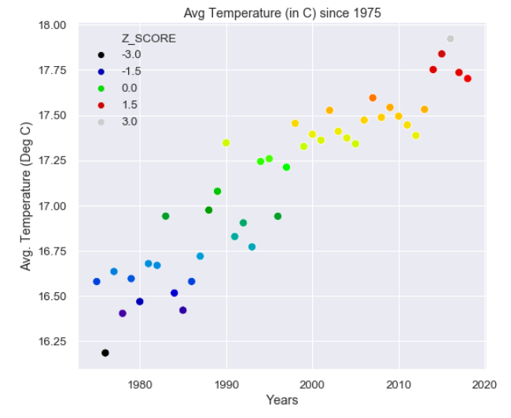
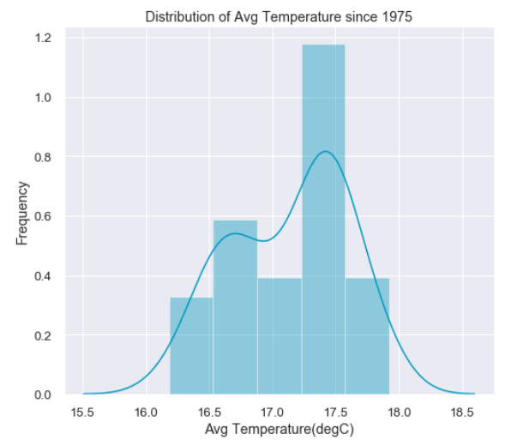
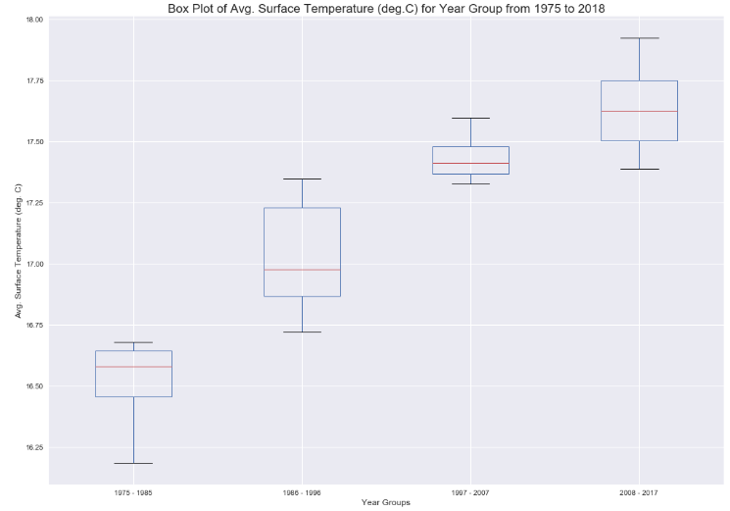
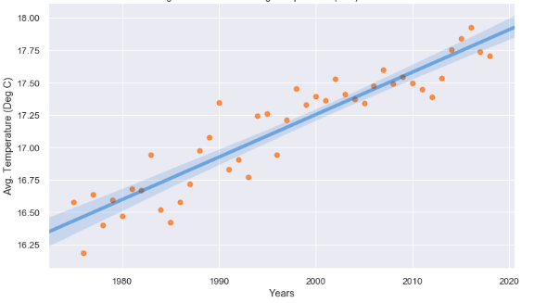
Analysis- Temperature Trends
Prove / Disprove the assumption Mean Temperature has been rising since 1975 statistically
Temperature vs Time over years (1975 to 2017)
Z-Distribution Plot
Shows a bimodal distribution of Temperature, indicating a shifting of mean temperature over time
ANNOVA:
Regression Line fit:
P-value obtained is 9.062676000950596e-20
P-Value shows 2.1713647641992118e-17

Slide 9
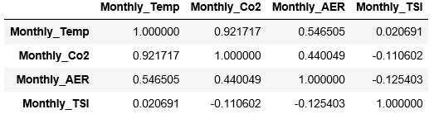
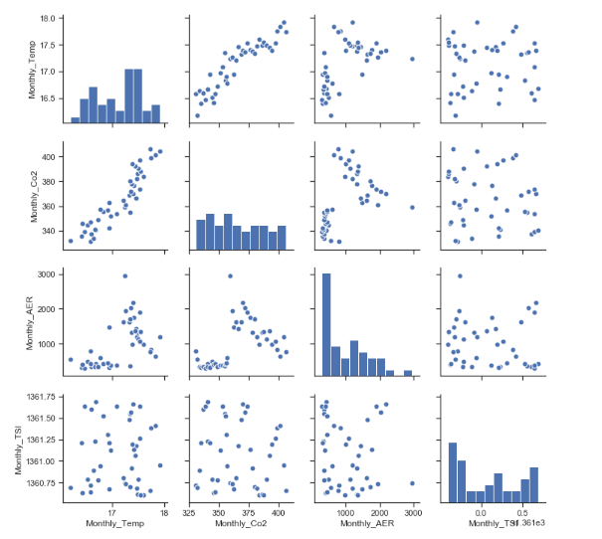
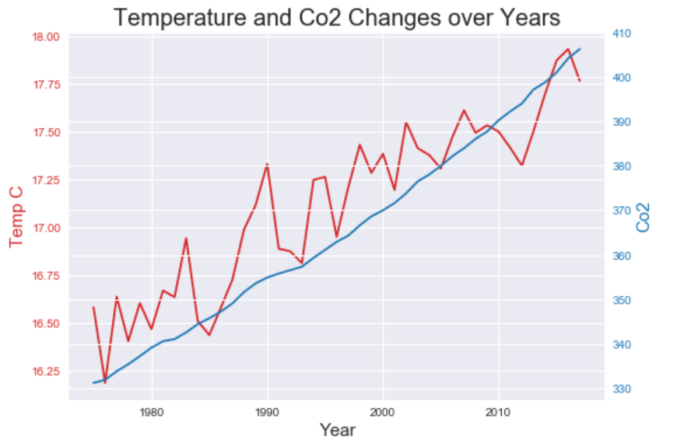
Correlation results

Slide 10
Conclusion
Solar
4
SOLAR IRRADIANCE
4
http://lasp.colorado.edu/lisird
d
Temp.
5
TEMPERATURE
5
ftp://ftp.ncdc.noaa.gov/pub/data/ghcn/v3
d
CO2
6
CO2
6
ftp://ftp.cmdl.noaa.gov/data/greenhouse_gases/co2/flask/surface
d

Slide 11
CITATIONS
Dlugokencky, E.J., P.M. Lang, J.W. Mund, A.M. Crotwell, M.J. Crotwell, and K.W. Thoning (2018), Atmospheric Carbon Dioxide Dry Air Mole Fractions from the NOAA ESRL Carbon Cycle Cooperative Global Air Sampling Network, 1968-2017, Version: 2018-07-31, Path: ftp://aftp.cmdl.noaa.gov/data/trace_gases/co2/flask/surface/.
CO2
J. H. Lawrimore, M. J. Menne, B. E. Gleason, C. N. Williams, D. B. Wuertz, R. S. Vose, and J. Rennie (2011), An overview of the Global Historical Climatology Network monthly mean temperature data set, version 3, J. Geophys. Res., 116, D19121, doi:10.1029/2011JD016187.
TEMPERATURE
This data comes from SORCE project sponsored by NASA – Satellite Program
SOLAR IRRADIANCE
Source 4 here.
CITATIONS
Source 5 here.
CITATIONS

Slide 12
THANK YOU!
ANY QUESTIONS?
Albert Gendelman
Guy Thompson
Madhuram Swaminathan
Steve Wang

